Slide 1
Example: Estimating Mood State from Grad Student Observations

Slide 2
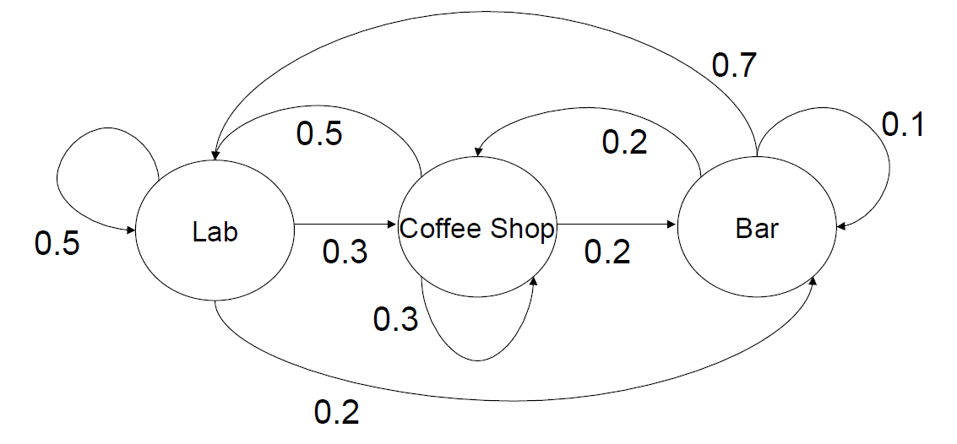
“Happy” Grad Student Markov Chain

Slide 3
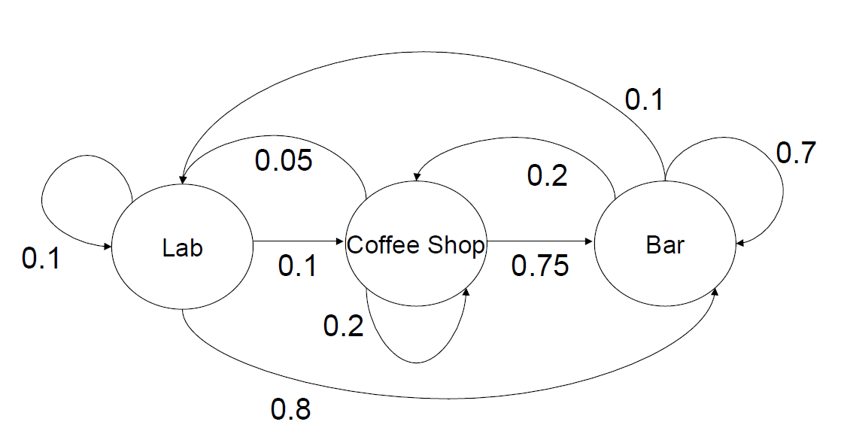
Depressed about research

Slide 4
Happy or Depressed?
Observations: Lab, Coffee, Lab, Coffee, Lab, Lab, Bar, Lab, Coffee,…

