Slide 1
Fundamental assumption of learning
Assumption: The distribution of training examples is identical to the distribution of test examples (including future unseen examples).
In practice, this assumption is often violated to certain degree.
Strong violations will clearly result in poor classification accuracy.
To achieve good accuracy on the test data, training examples must be sufficiently representative of the test data.

Slide 2
Decision tree induction

Slide 3
Introduction
Decision tree learning is one of the most widely used techniques for classification.
Its classification accuracy is competitive with other methods, and
it is very efficient.
The classification model is a tree, called decision tree.

Slide 4
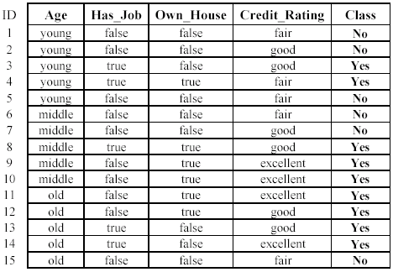
The loan data (reproduced)
Approved or not

Slide 5
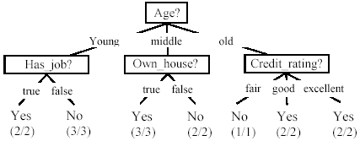
A decision tree from the loan data
Decision nodes and leaf nodes (classes)

Slide 6
Use the decision tree
No

Slide 7
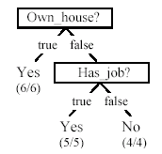
Is the decision tree unique?
No. Here is a simpler tree.
We want smaller tree and accurate tree.
Easy to understand and perform better.
Finding the best tree is NP-hard.
All current tree building algorithms are heuristic algorithms

Slide 8
From a decision tree to a set of rules
A decision tree can be converted to a set of rules
Each path from the root to a leaf is a rule.

Slide 9
Algorithm for decision tree learning
Basic algorithm (a greedy divide-and-conquer algorithm)
Assume attributes are categorical now (continuous attributes can be handled too)
Tree is constructed in a top-down recursive manner
At start, all the training examples are at the root
Examples are partitioned recursively based on selected attributes
Attributes are selected on the basis of an impurity function (e.g., information gain)
Conditions for stopping partitioning
All examples for a given node belong to the same class
There are no remaining attributes for further partitioning – majority class is the leaf
There are no examples left

Slide 10
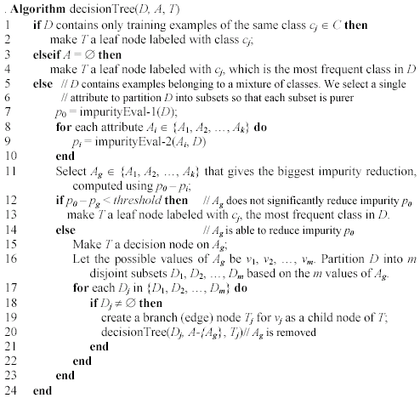
Decision tree learning algorithm

