Slide 1
Data Science
Dr. Chengwei Lei
CEECS
California State University, Bakersfield

Slide 2
Data Mining: Confluence of Multiple Disciplines
Machine
Learning
Pattern
Recognition
Statistics
Applications
Data Mining
Visualization
Algorithm
Database
Technology
High-Performance
Computing

Slide 3
Traditional Hypothesis Driven Research
Hypothesis
Design
Experiment
Data
Data analysis
Result

Slide 4
Data Driven Science
Process/Experiment
Data
No Prior Hypothesis
New Science of Data

Slide 5
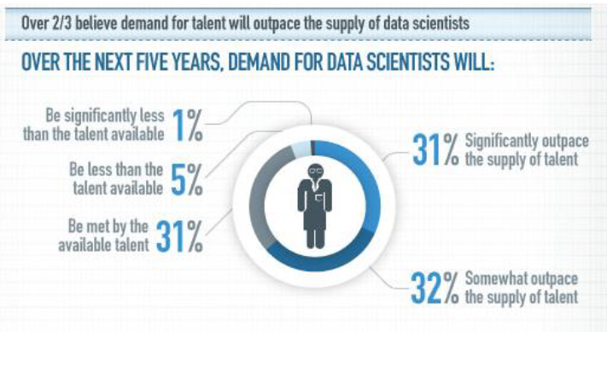
Demand will outpace supply

Slide 6
Where does data come from?

Slide 7
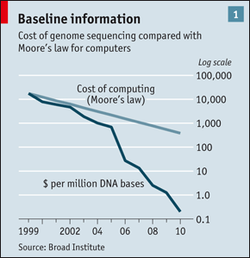
“Big Data” Sources
It’s All Happening On-line
User Generated (Web & Mobile)
Every:
Click
Ad impression
Billing event
Fast Forward, pause,…
Server request
Transaction
Network message
Fault
…
…..
Internet of Things / M2M
Health/Scientific Computing

Slide 8
Graph Data
Lots of interesting data
has a graph structure:
Social networks
Communication networks
Computer Networks
Road networks
Citations
Collaborations/Relationships
…
Some of these graphs can get
quite large (e.g., Facebook*
user graph)

Slide 9
“Data is the New Oil”
Notes:
“Data is the new oil." Coined in 2006 by Clive Huby, a British data commercialization entrepreneur, this now famous phrase was embraced by the World Economic Forum in a 2011 report,
All human generated information up to 2003 is 5 exabytes. Same amount of data was generate every 2 days in 2011 and would be every 10 min NOW.
Data is just like crude oil. It’s valuable, but if unrefined it cannot really be used. It has to be changed into gas, plastic, chemicals, etc to create a valuable entity that drives profitable activity; so must data be broken down, analyzed for it to have value.

Slide 10
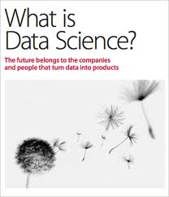
“Data Science” an Emerging Field
O’Reilly Radar report, 2011

Slide 11
Data Science – A Definition
Data Science is the science which uses computer science, statistics and machine learning, visualization and human-computer interactions to collect, clean, integrate, analyze, visualize, interact with data to create data products.

Slide 12
Goal of Data Science
Turn data into data products.

Slide 13
How to use data?
Data => exploratory analysis => knowledge models => product / decision marking
Data => predictive models => evaluate / interpret => product / decision making

Slide 14
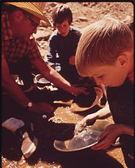
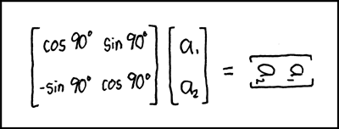
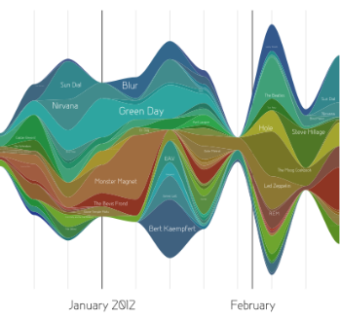
Data Scientist’s Practice
Clean,
prep
Hypothesize Model
Large Scale Exploitation
Digging Around in Data
Evaluate Interpret

Slide 15
Example data science applications
Marketing: predict the characteristics of high life time value (LTV) customers, which can be used to support customer segmentation, identify upsell opportunities, and support other marking initiatives
Logistics: forecast how many of which things you need and where will we need them, which enables learn inventory and prevents out of stock situations
Healthcare: analyze survival statistics for different patient attributes (age, blood type, gender, etc.) and treatments; predict risk of re-admittance based on patient attributes, medical history, etc.

Slide 16
More Examples
Transaction Databases → Recommender systems (NetFlix), Fraud Detection (Security and Privacy)
Wireless Sensor Data → Smart Home, Real-time Monitoring, Internet of Things
Text Data, Social Media Data → Product Review and Consumer Satisfaction (Facebook, Twitter, LinkedIn), E-discovery
Software Log Data → Automatic Trouble Shooting (Splunk)
Genotype and Phenotype Data → Epic, 23andme, Patient-Centered Care, Personalized Medicine

Slide 17
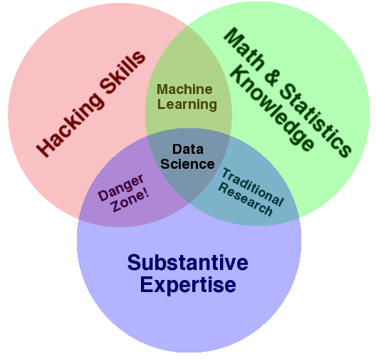
Data Science – One Definition
Notes:
Drew Conway’s definition

Slide 18
What’s Hard about Data Science
Overcoming assumptions
Making ad-hoc explanations of data patterns
Overgeneralizing
Communication
Not checking enough (validate models, data pipeline integrity, etc.)
Using statistical tests correctly
Prototype → Production transitions
Data pipeline complexity (who do you ask?)
Notes:
Quote from paper “I’d rather the data go away than be wrong and not know”
Assumptions not communicated: transformations not documented.

