Slide 1
Presentations on Project Progress Report Presentation
For: Utilizing Data Mining Technologies to Analyze the Physical and Cognitive Benefits of Golf Therapy on Seniors
By
Steven Merino
Clemente Rodriguez
McKay Russell
Zachary Scholefield

Slide 2
Quick Summary so Far
A Reminder:
Seniors and Golf Therapy
Combining a big file of CSV files

Slide 3
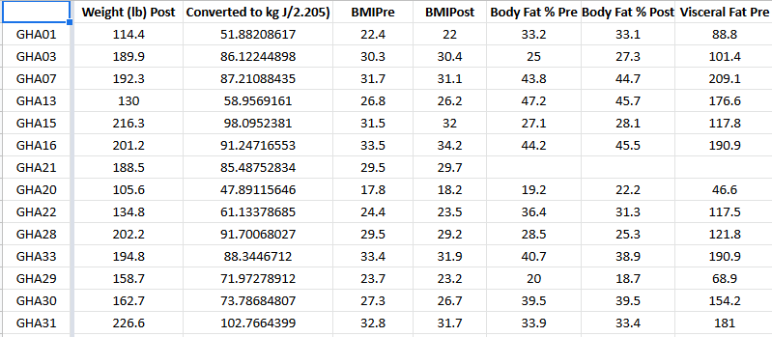
The data and CSVs
A screen capture of our merged file
Link to the file on Dr. Lei’s website: https://cs.csub.edu/~clei/research/stu_projects/Golf_therapy/Golf_therapy.html
Contains:
Various percent change
Weight of participants
BMI of participants

Slide 4
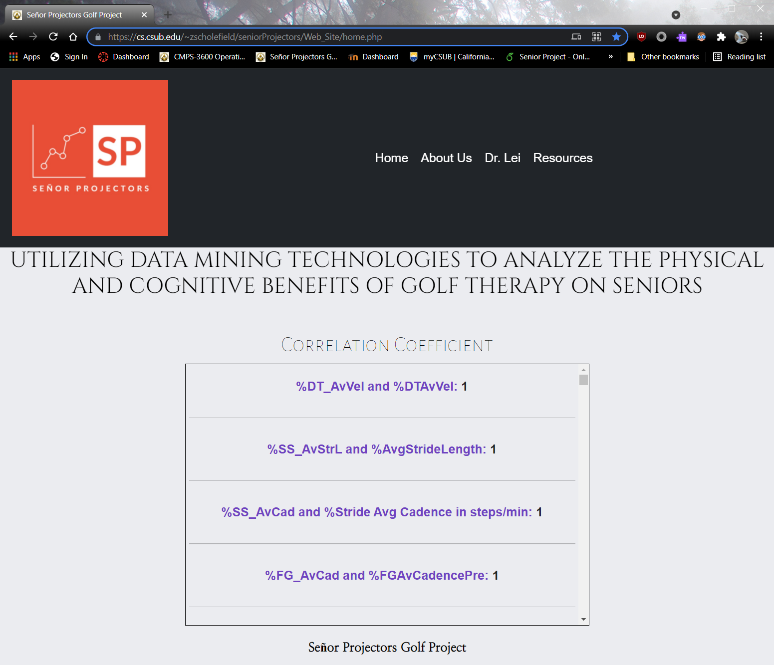
Our web page
Contains:
Calculated correlation coefficients
https://cs.csub.edu/~zscholefield/seniorProjectors/Web_Site/home.php
More interactive features:
Top correlations
Least correlations
Heat map

Slide 5
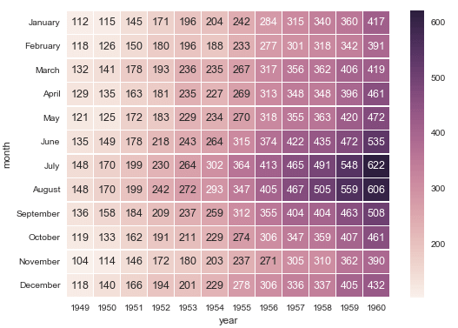
Next steps...
Two other things we need to add to our webpage:
Heatmap of the data (Interactive) - looking into using python to create the heatmap.
Ability to choose a column value and have the matching row name and correlation coefficient appear
Image source: https://blog.quantinsti.com/creating-heatmap-using-python-seaborn/

