Slide 1
Simplifying Ultrasound Imaging with Augmented Reality: A Guide to Enhanced Usability and Procedure Navigation
By : Alia Marzooq Al-Maitah & Joseph Brian Rivera
This Photo by Unknown author is licensed under CC BY-SA.

Slide 2
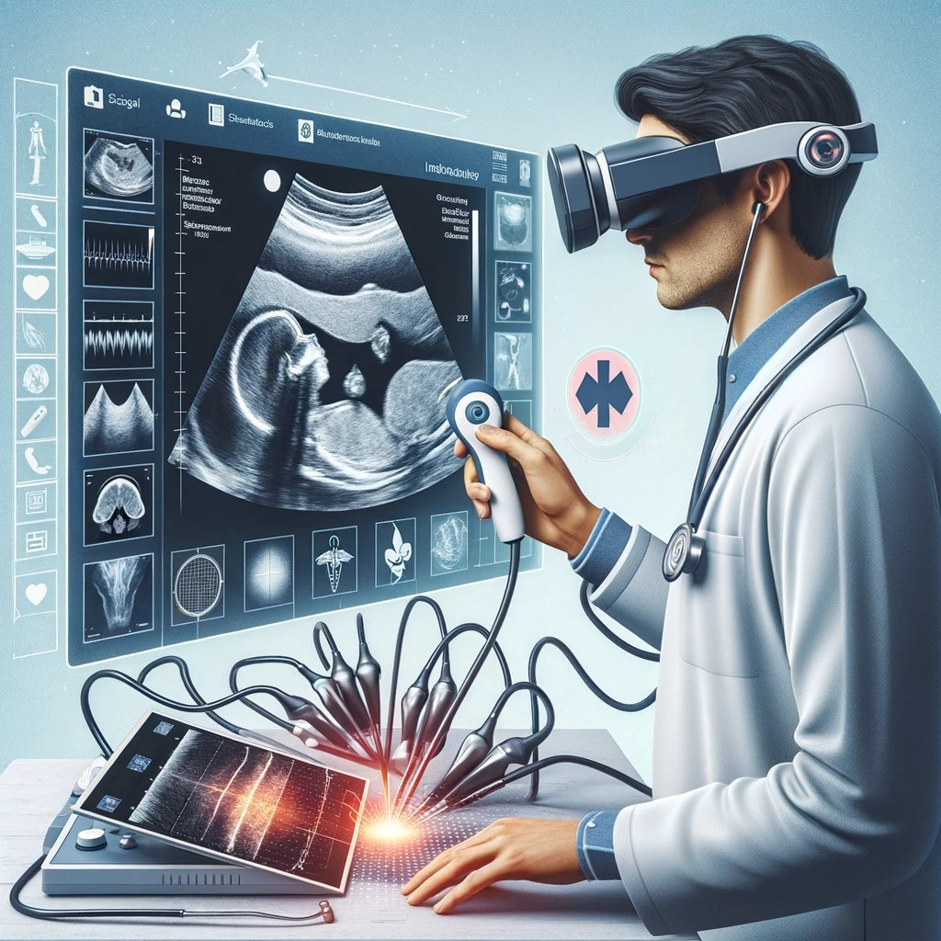
Introduction:
Overview of Augmented Reality Technology
The Role of AR in Modern Healthcare

Slide 3
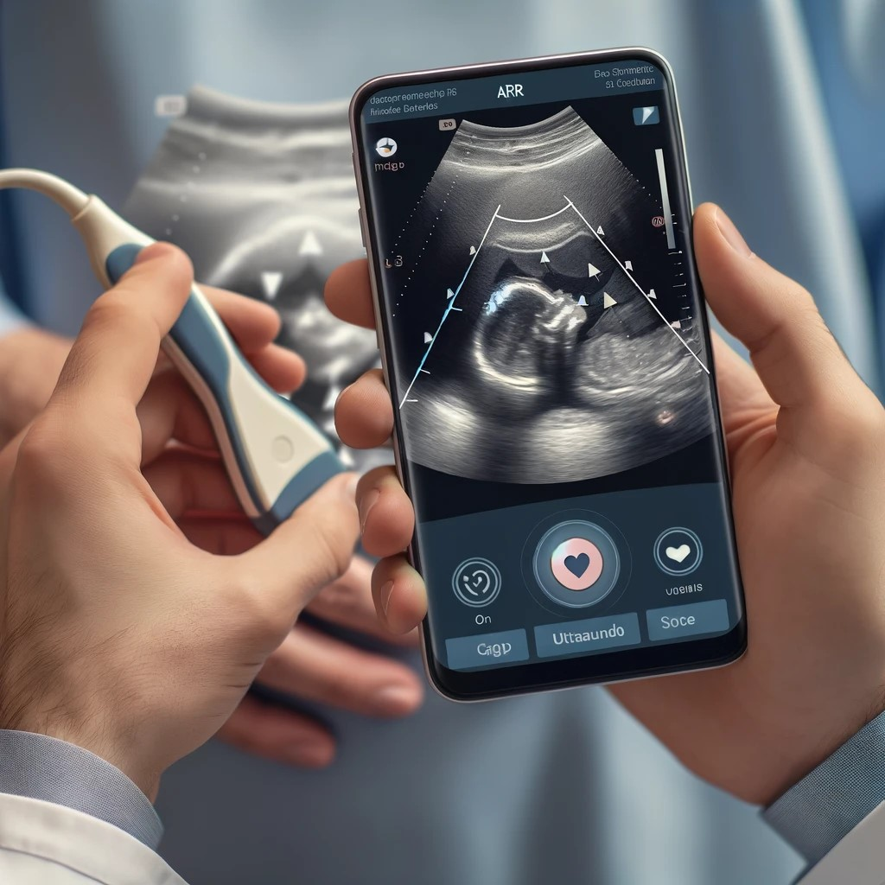
Problem
Challenges in traditional ultrasound training.
AR's role in enhancing learning and diagnostic processes.

Slide 4
Objectives:
Bridging the gap between ultrasound technology and healthcare professionals.

Slide 5
Technology
Utilizing AR Core, Unity, Adobe XD, and Android Studio.
- Development process rationale for an AR mobile app.

Slide 6
Expected Impact
Increased accessibility
Support for medical education and remote diagnostics.

Slide 7
Timeline
~Week 9:
Ultrasound Transducer connected to device
Week 5: Project Presentation
~Week 7:
Have basic app developed using AR
~Week 12-15:
Testing and Debugging

Slide 8
Conclusion
The significance of AR in advancing medical technology and improving healthcare outcomes.
Ultrasounds being accessible no matter the location

