Slide 1
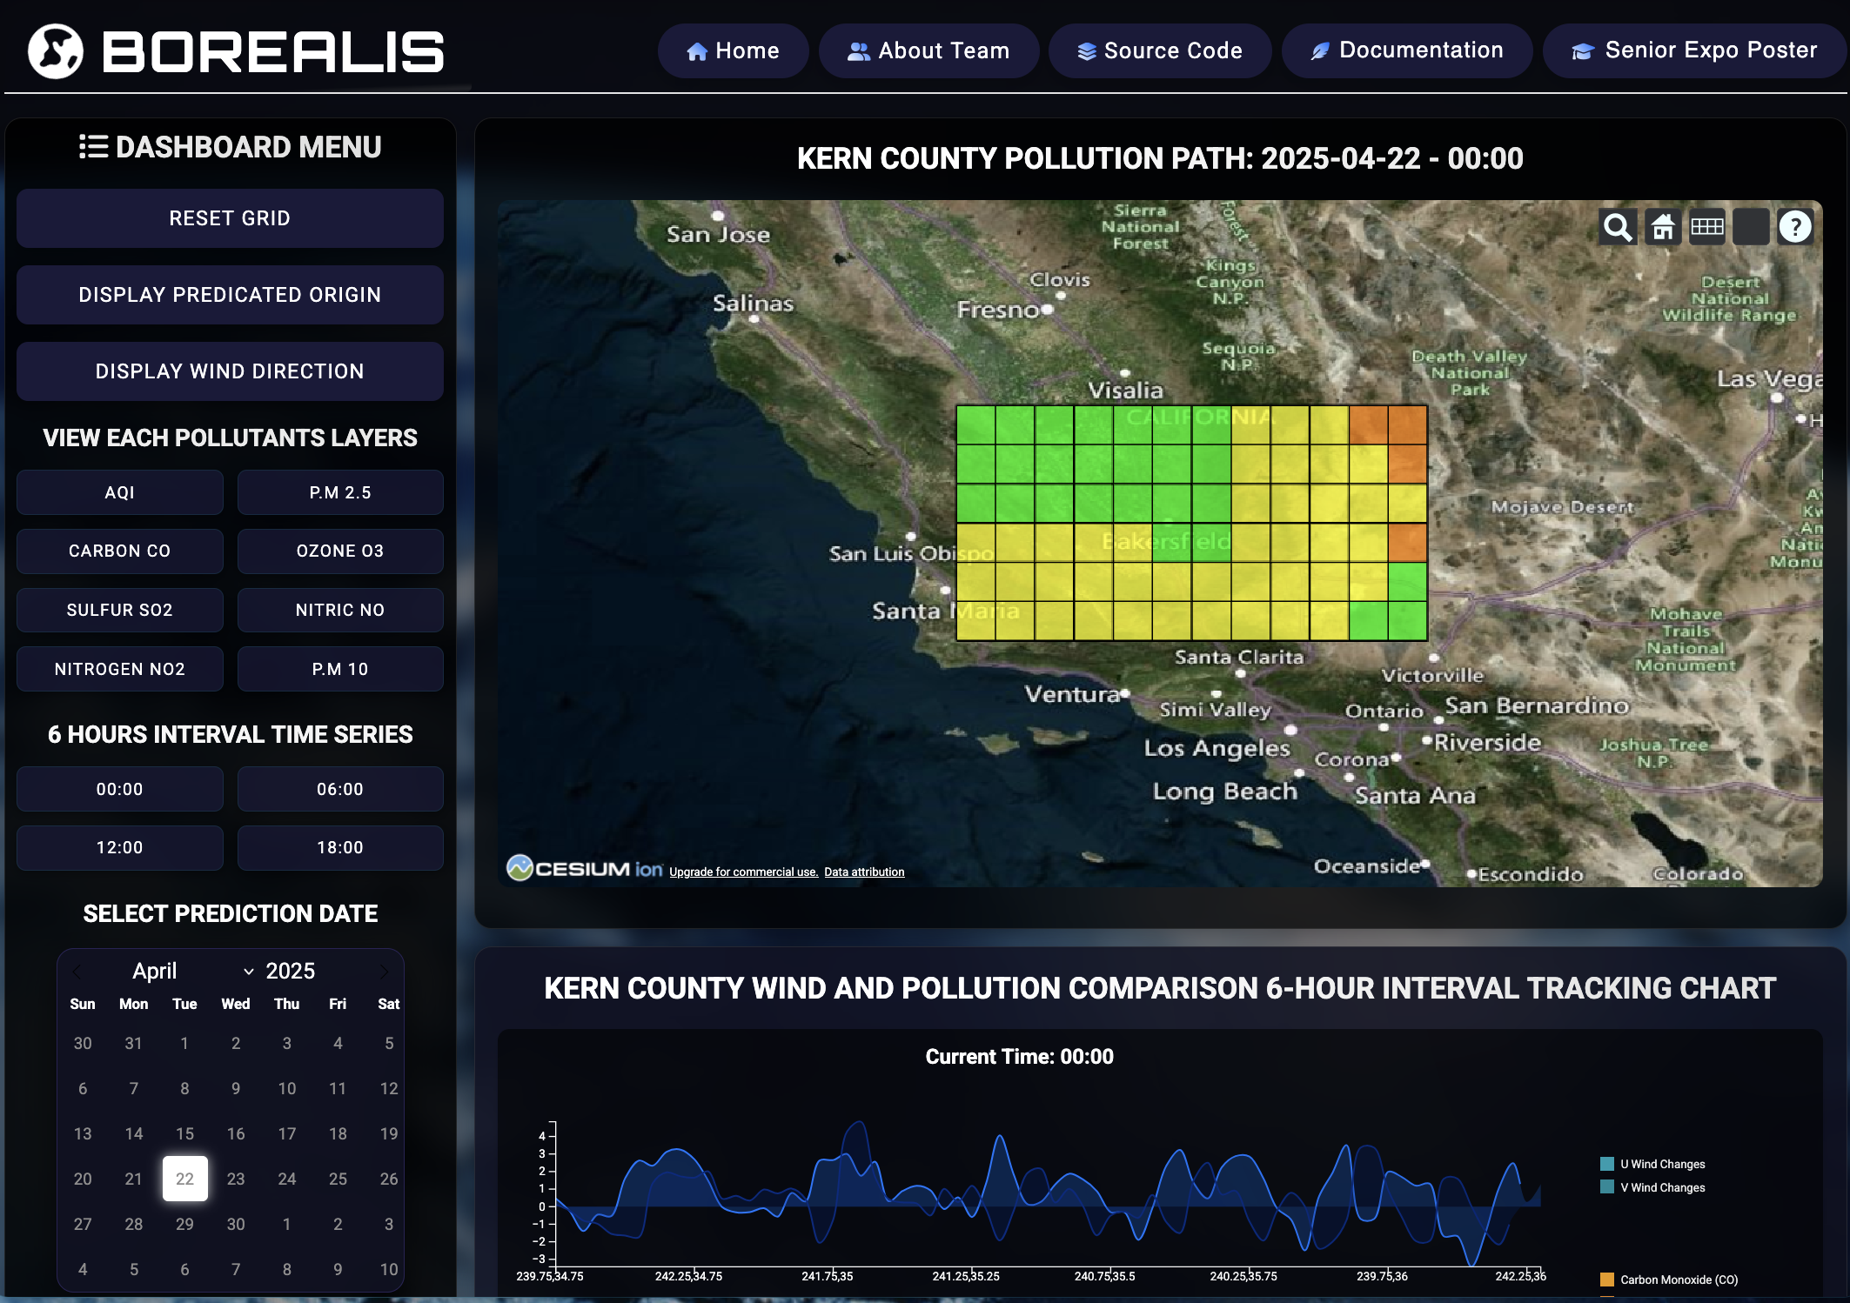
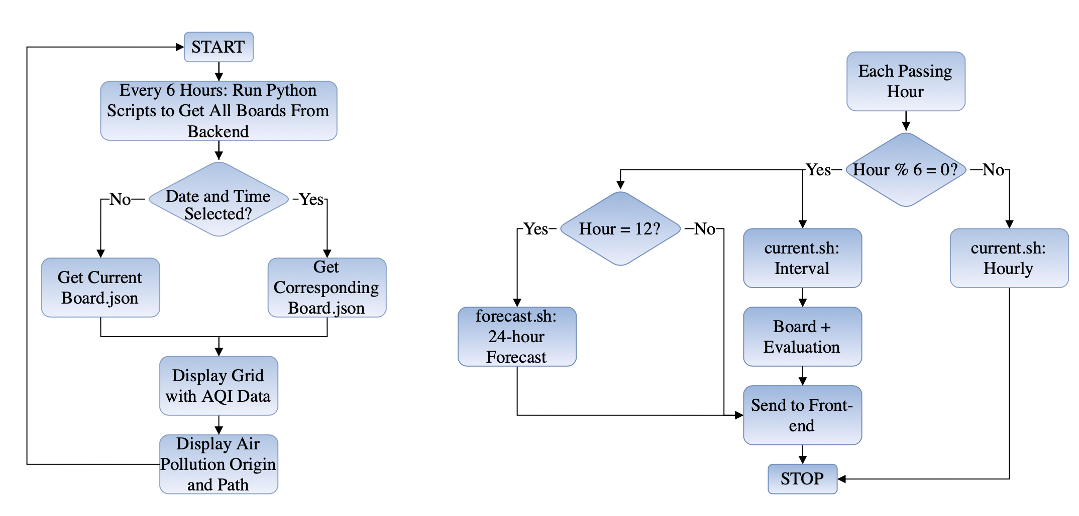
CSU Bakersfield
School of Natural Sciences, Mathematics, and Engineering
BOREALIS: TRACKING POLLUTION IN KERN COUNTY USING WEATHER PATTERNS​
Andy Ceballos, Jose Zamora, Lucia Y Rojo Angulo, Vo Hong Vy Le​
Project Introduction
Project Results Overview
How Does This Work ?
This project aims to create an accessible and intuitive air pollution tracking application focused on highly affected regions such as Kern County, California. By integrating real-time air quality data, wind patterns, and AI models, the app provides detailed pollution source tracking and movement forecasts.
Back-end server: Using Python libraries to get the data from Aurora into JSON files . Ensure the forecast data accuracy.
Front-end server: Using Javascript HTML CSS and D3 libraries to visualization the dataset from backend (on map grid and charts) and design a responsive website on Athena.
What Is The Problem ?
Database server: Organized CSV/JSON format, clean data from back-end and save to archive.
Air pollution is a major issue worldwide, especially in areas like Kern County, one of the most polluted regions in the U.S. Existing weather apps often show current air quality but lack details on pollution sources or movement. While advanced tools exist, they are often complex and not user-friendly. There’s a clear need for an accessible app that offers reliable pollution tracking and forecasts.
Project Challenges
Our backend can face delays due to outdated data and limited GPU VRAM on Athena, forcing slow batch predictions. Accurate results require uninterrupted runs, and hourly forecasting is too time-consuming. Lower-resolution models could help, but current hardware can't support them without further optimization.
Project Final Architecture Flow Chart
How This Problem Can Be Solved
Project Features
Our solution for this is to build a user-friendly tool that predicts the origin and movement of air pollution. It collects AQI data from APIs, wind patterns from a simplified version of Microsoft’s Aurora, and archives additional data from algorithm. The model then forecasts air pollution trajectories, which are displayed on an interactive 3D map hosted on Athena, making complex data easy to access and understand.
Display predicated pollution pathway
Display wind direction based on picked time
2D Locked Grid Mapping for Kern County
Enhanced GUI and Data Visualization
Multi-Format Environmental Data Display
6-Hour Real Time Series for AQI and Pollutants
Calendar Picker for Date-Based Analysis
Acknowledgements
Special thanks to our instructor, Dr. Chengwei Lei, who has provided us with excellent feedback and guidance for our project throughout the year, and Dr. Alberto Cruz for allowing us access to and assisting us in setting up the Athena server for our project.
Development Sources
Client-side
Server-side
Department of Computer and Electrical Engineering and Computer Science

